Slide 1
University Management System
Made by:
Mariam Mohamed (IS)
Shrouk Mohsen(CS)
Yosra Mamdouh(IS)
Hadeer Tamer(IS)
Nourihan Khaled (IS)
Salma Gamal(CS)

Slide 2
University Management System
Make it easy to manage University

Slide 3
Project needs
Database In SQL.
01
Using first code with .NET development with MVC.
Made ERD Diagram.
Gannt chart.
02
Using Microsoft project.
Display the phases of project.
DFD(Data Flow Diagram)
03
The flow that the project will go with
Make project clear and easy.
Figma.
04
Make it easy to see how website work.
make it easy to change color,text,photos.

Slide 4
Our database in SQL

Slide 5
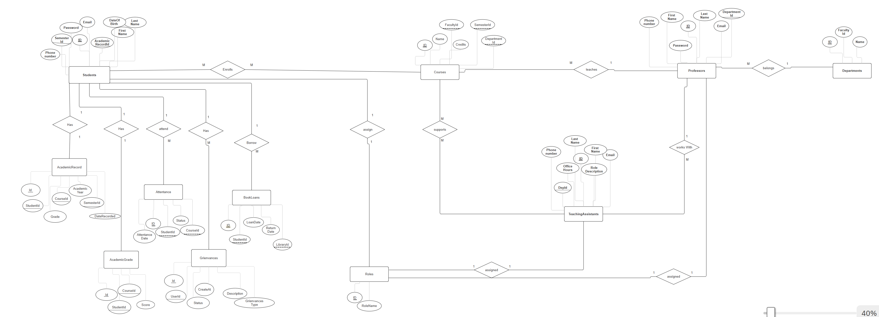
ERD

Slide 6
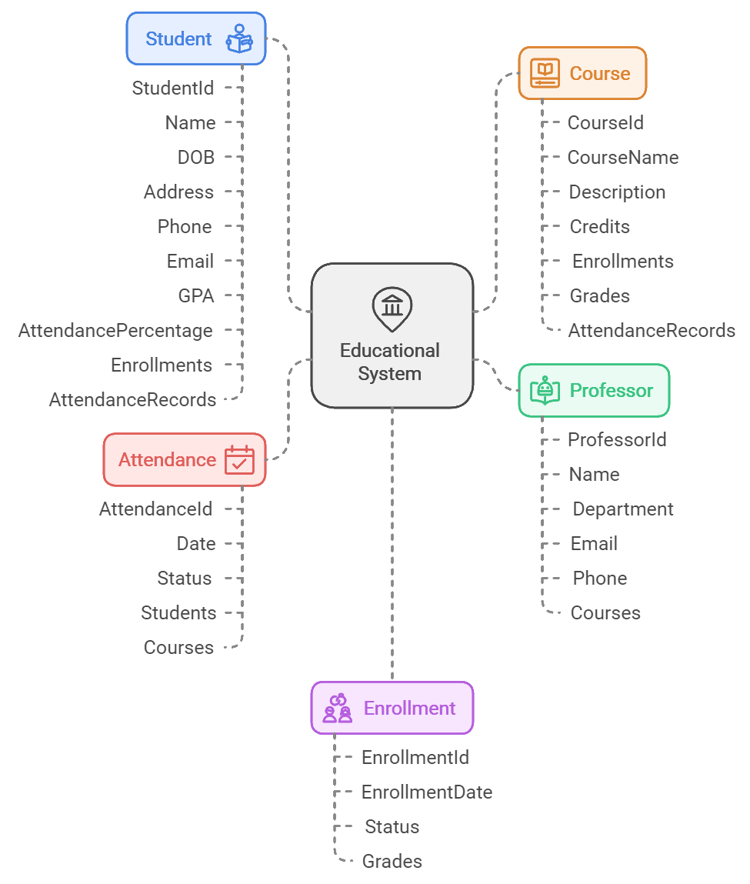
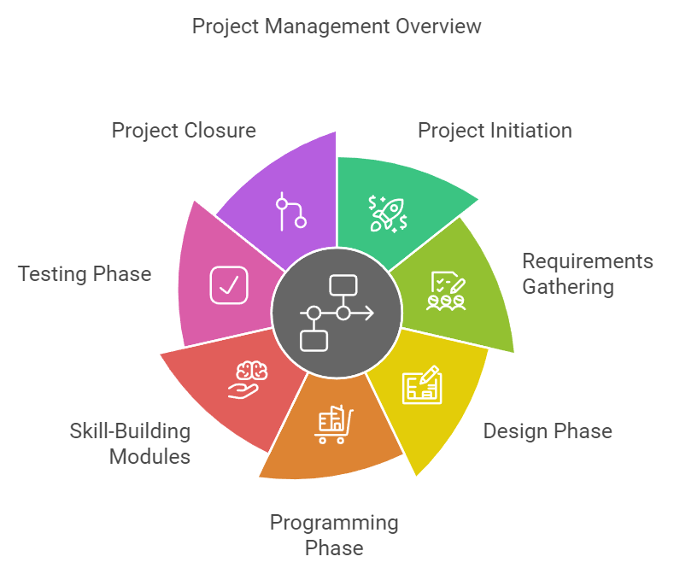
Project phases
Simple graphs
ERD in other Graph

Slide 7
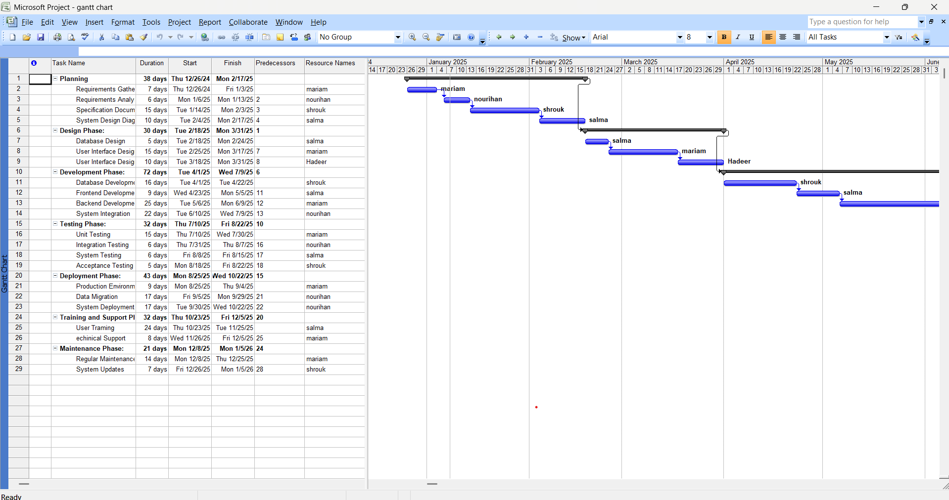
Gannt chart

Slide 8
Infographic Style
START
LOGIN
Finance and Fees
View Grades and Transcripts
View Current Courses
Enroll in a Course
FINISH
View Student Performance Reports
View news about Faculty

Slide 9
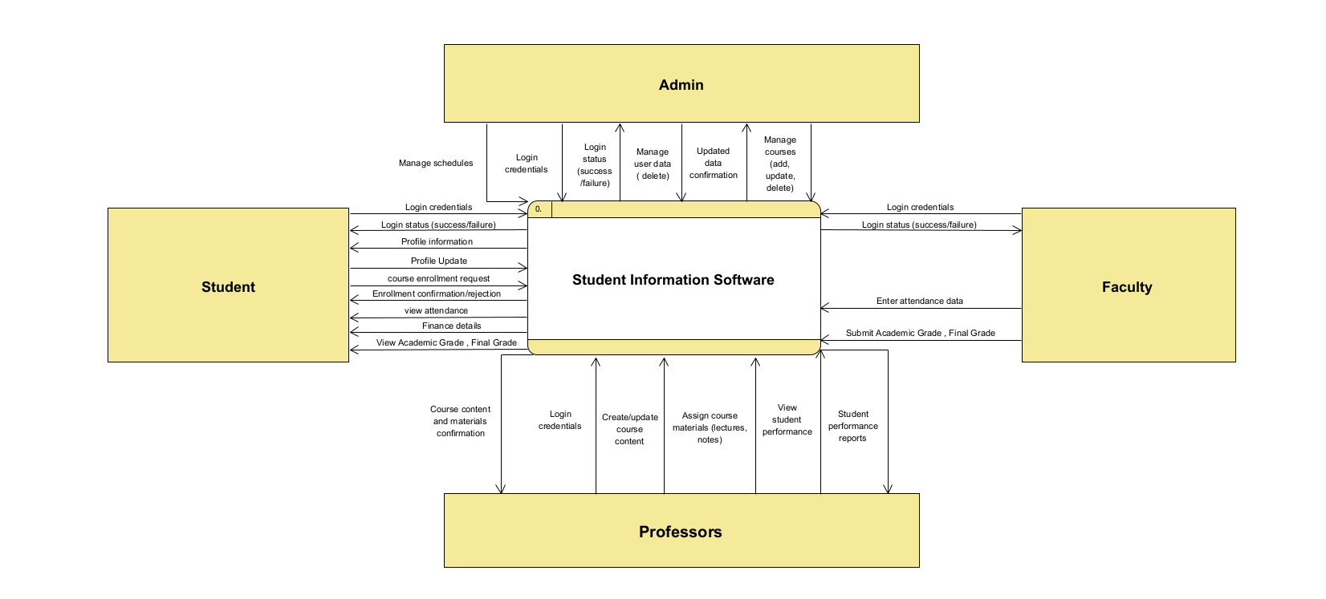
Context Diagram

Slide 10
DFD 1

Slide 11
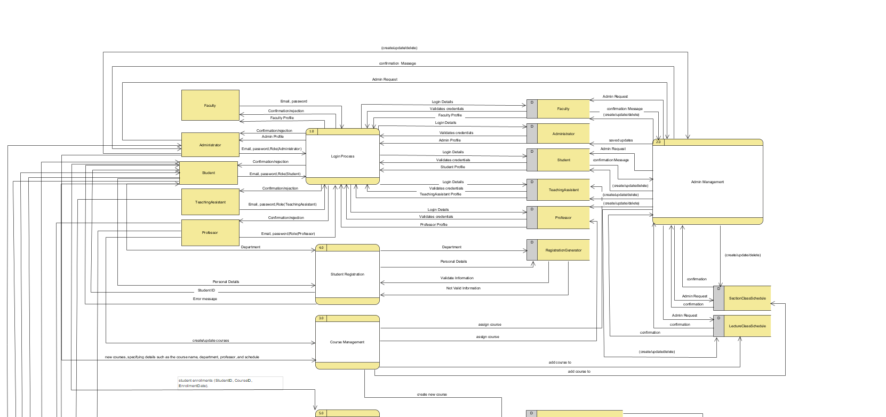

Slide 12
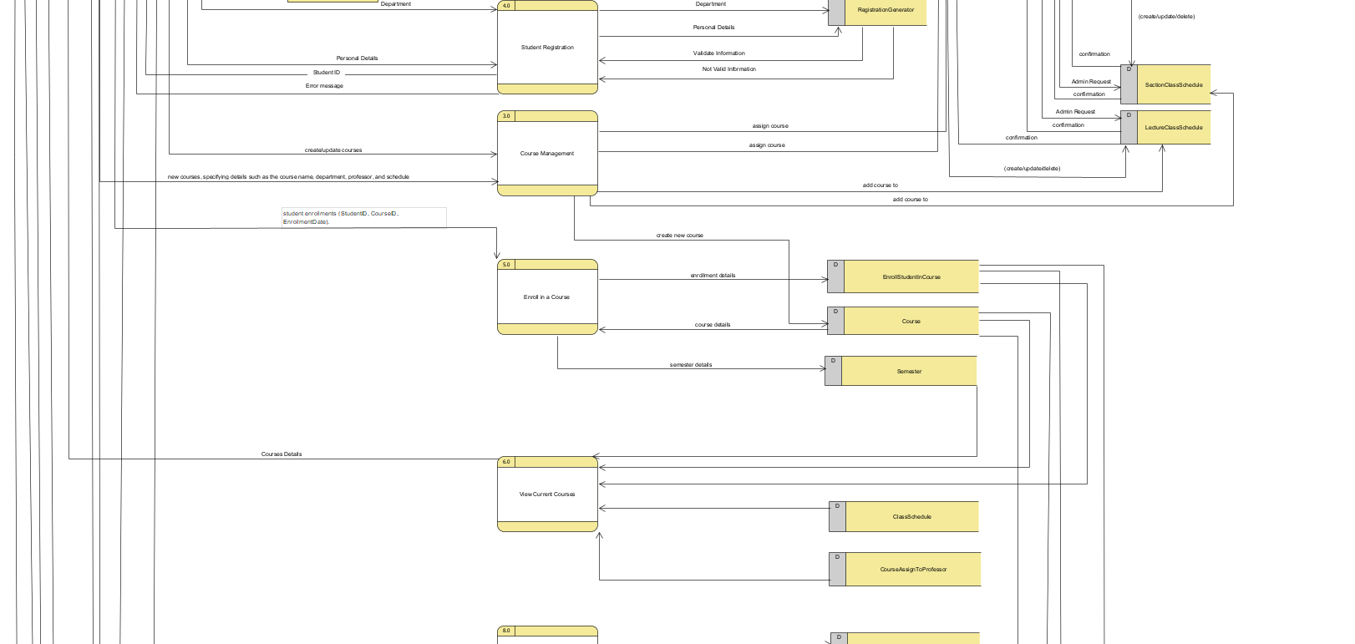

Slide 13
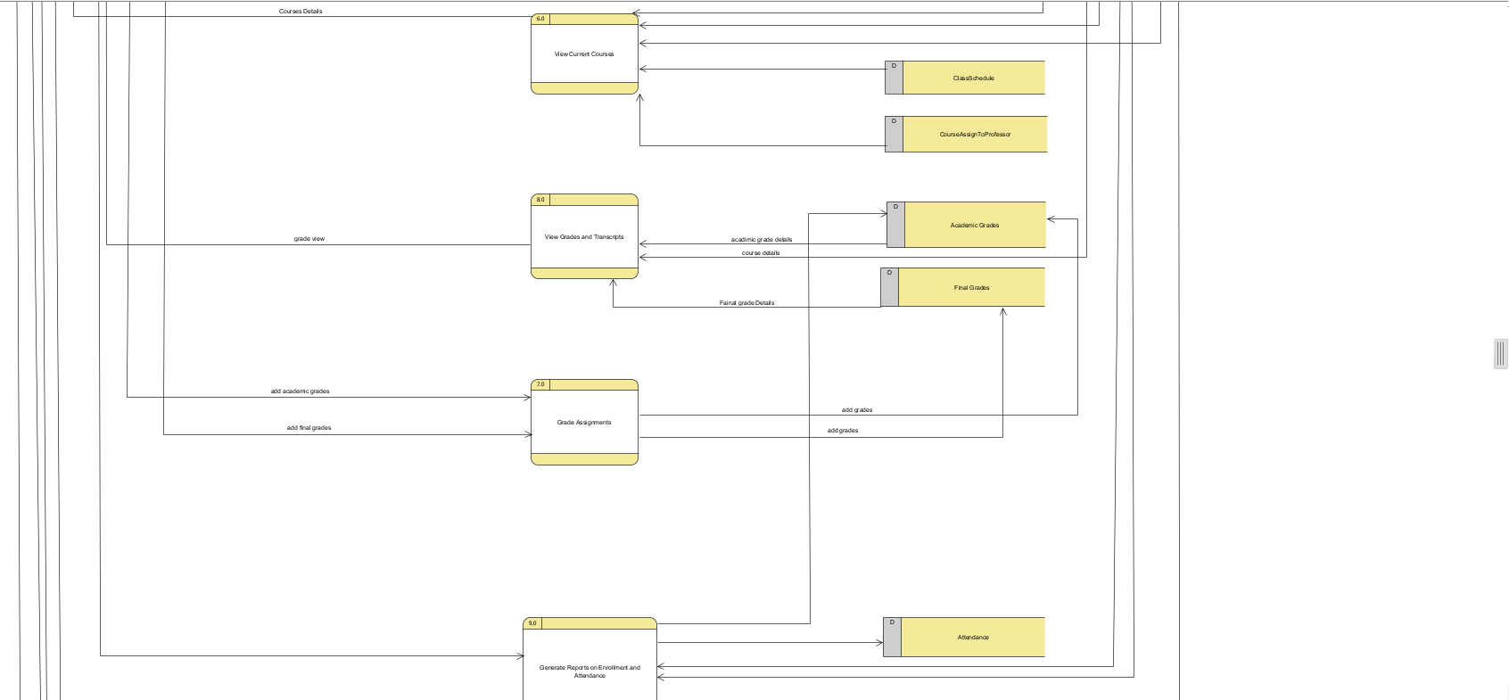

Slide 14
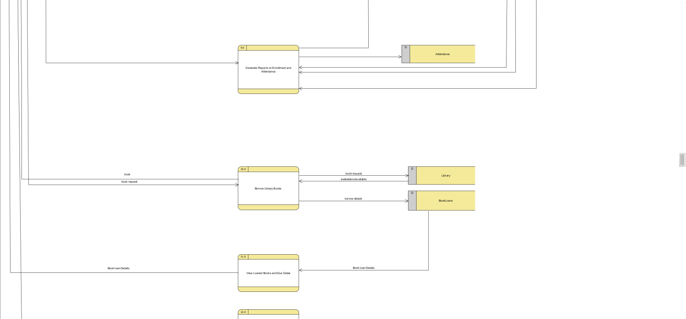

Slide 15
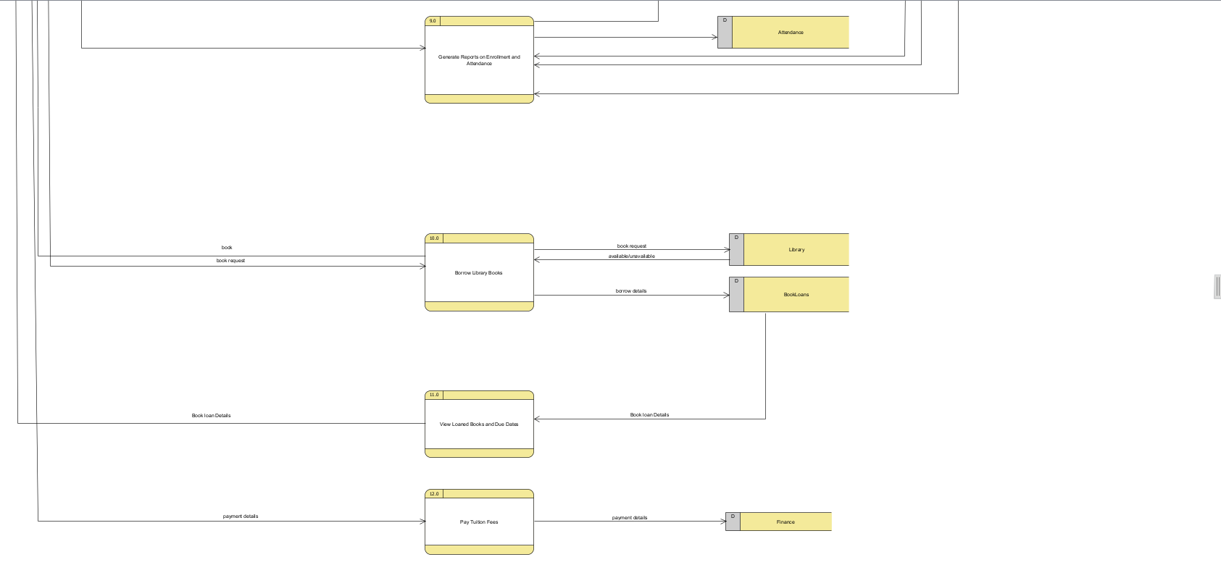

Slide 16
DFD 2

Slide 17
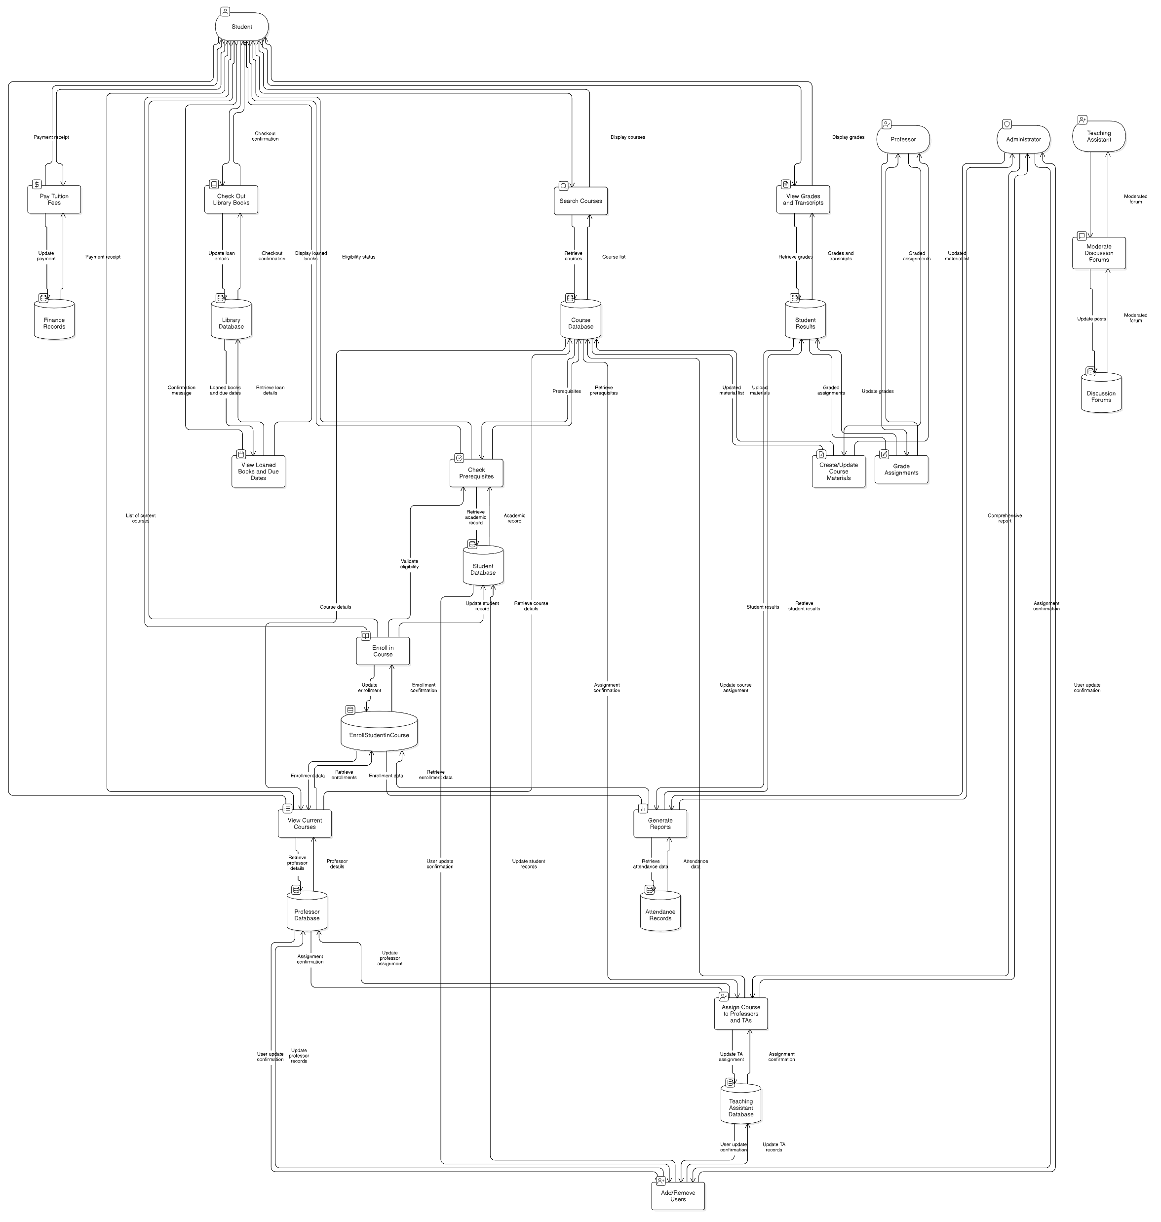

Slide 18
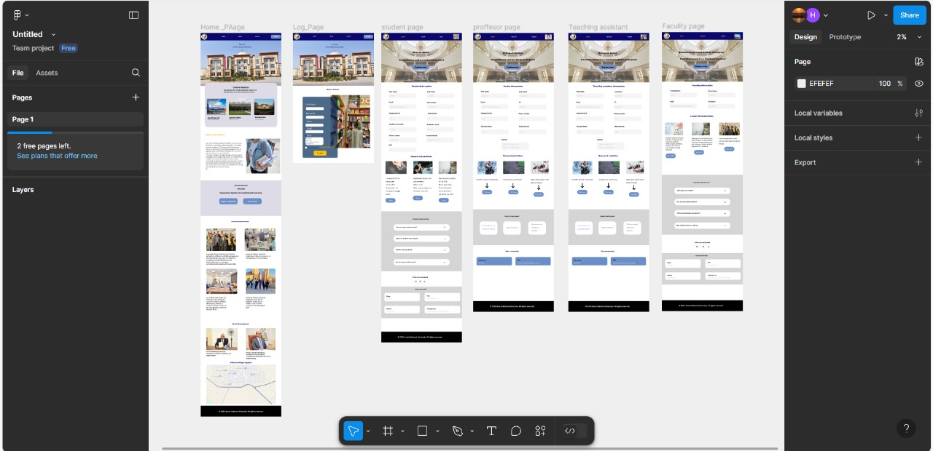

Slide 19
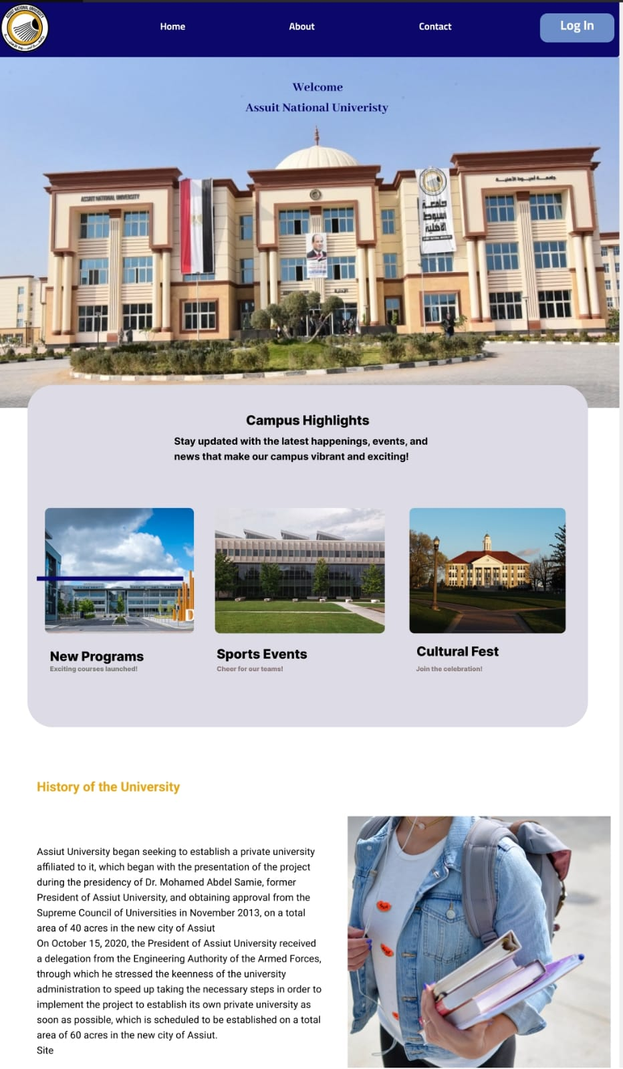
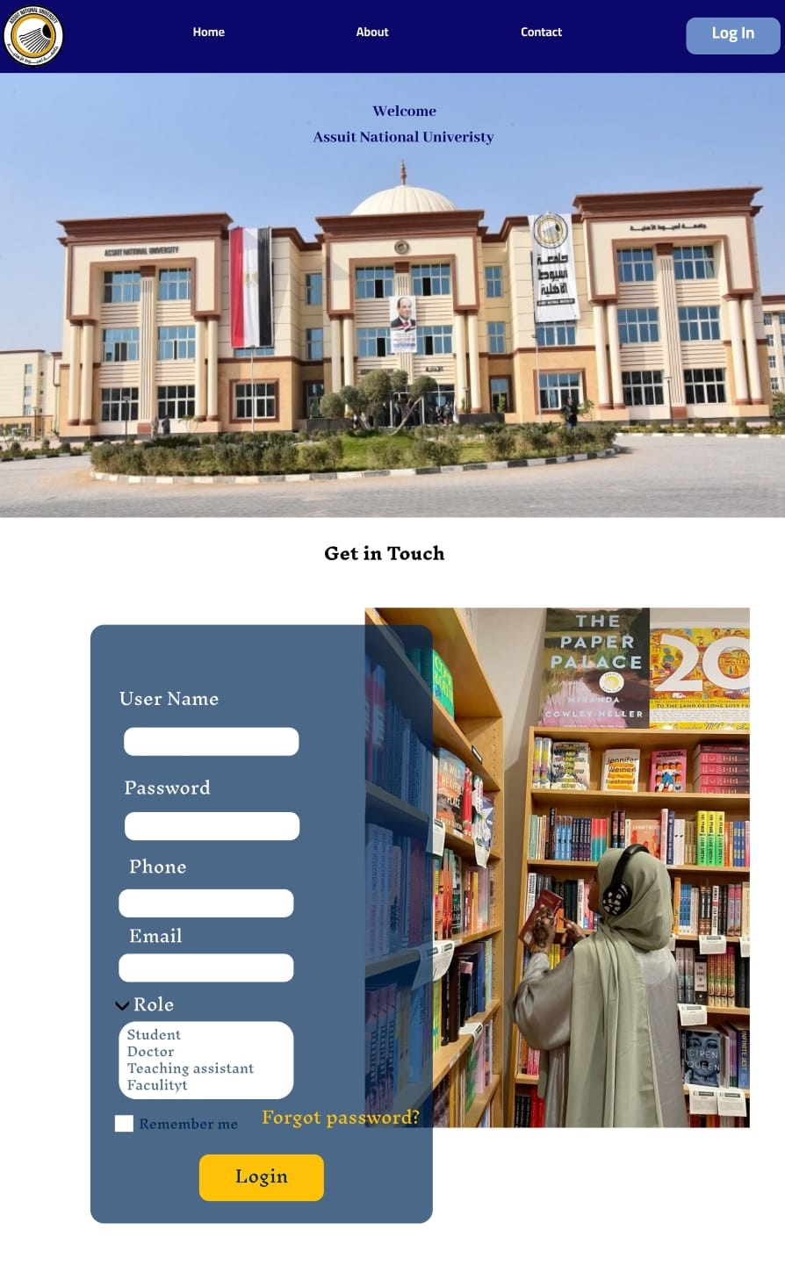
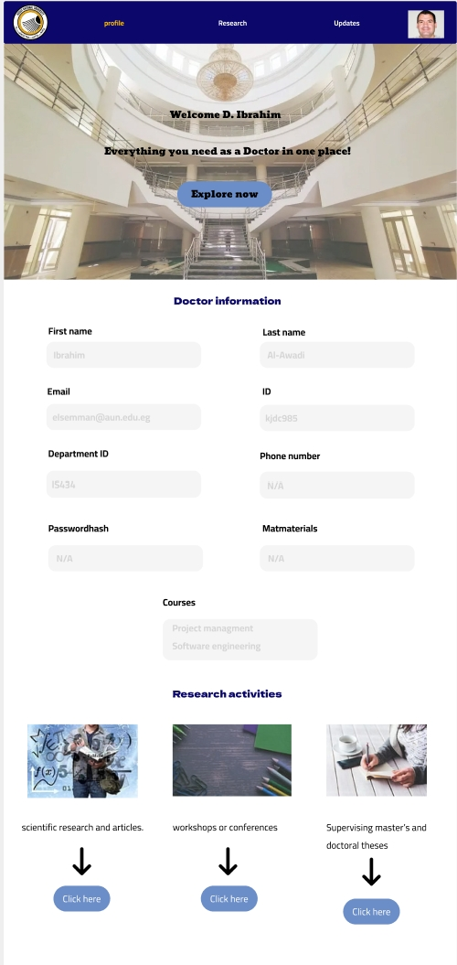
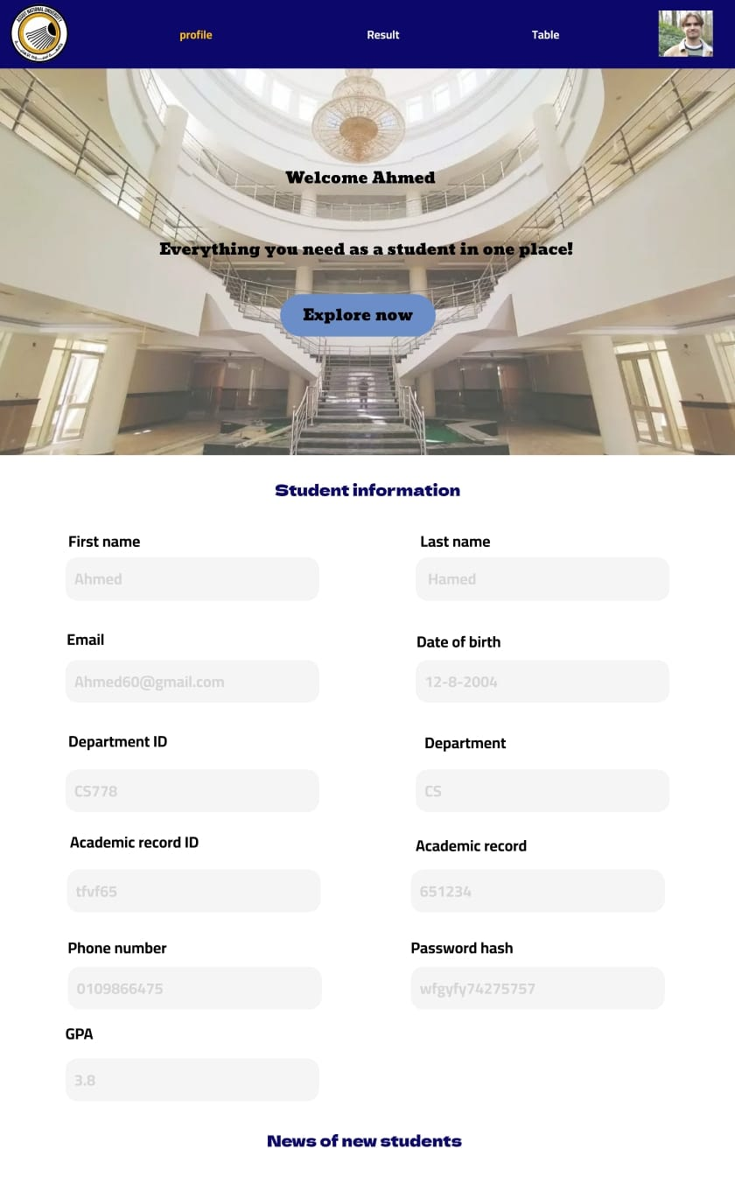
Our Figma
Home page
Login page
Professor page
Student page
https://www.figma.com/design/e5QNrT9OGsPoQ8o0NFkp8e/Untitled?node-id=0-1&t=nuHLsqzUvLAZ6Mqj-1

Slide 20
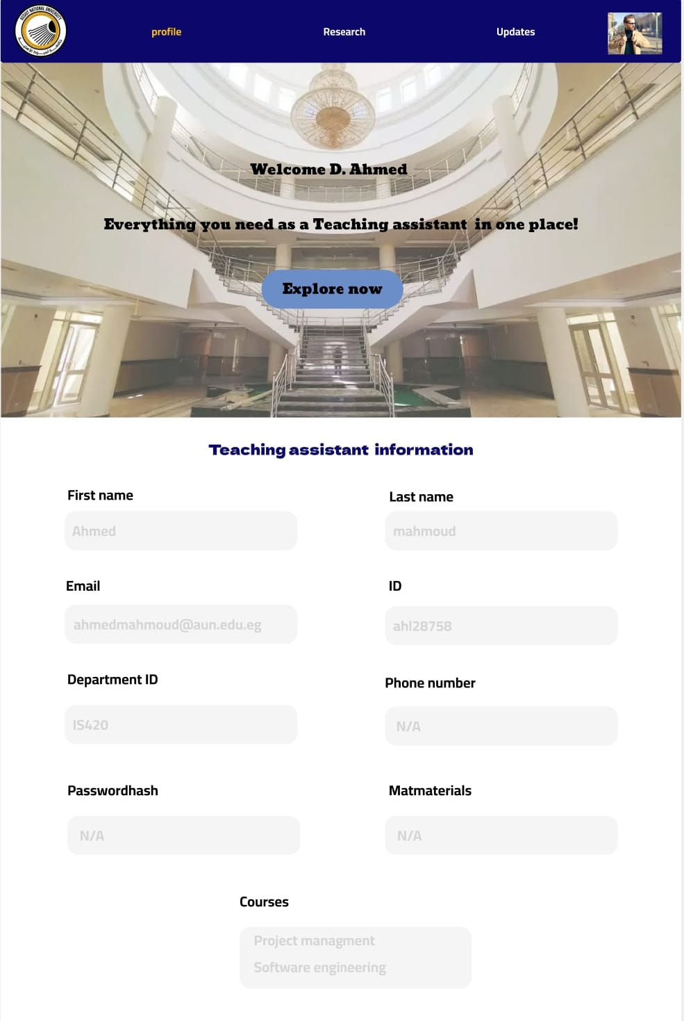
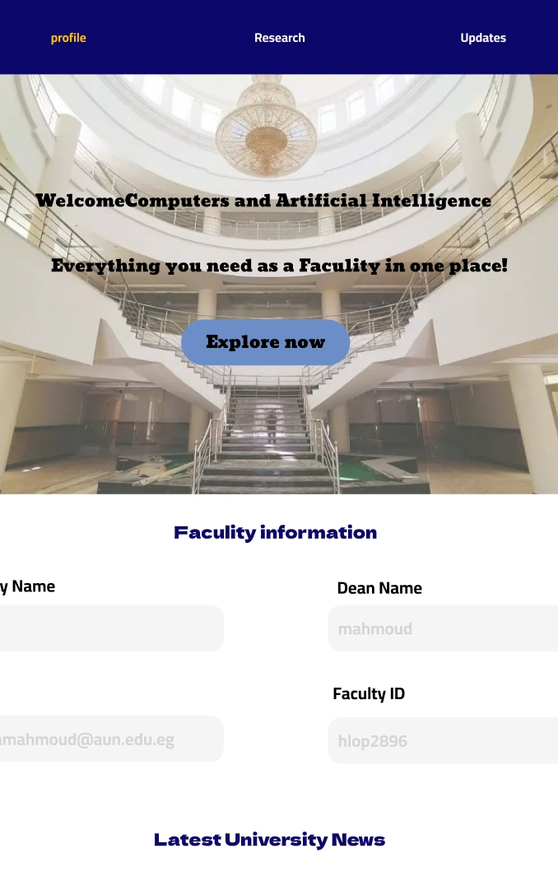
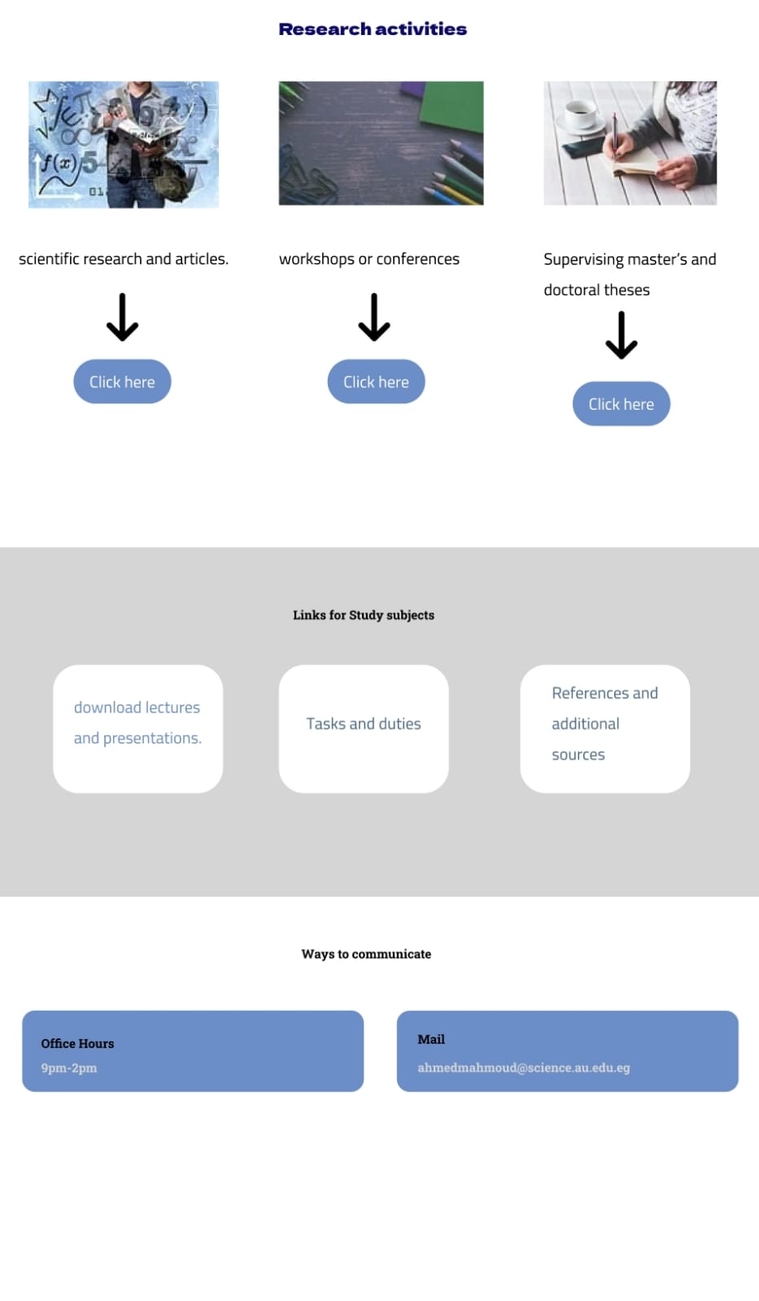
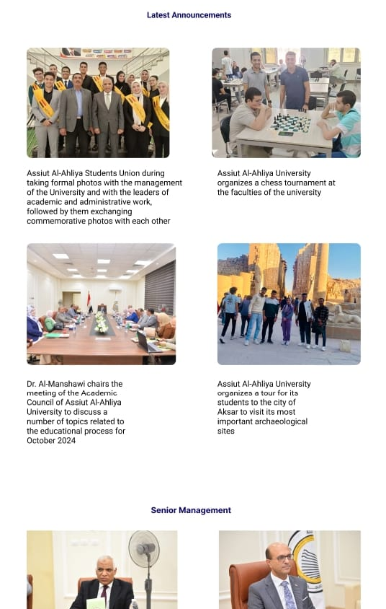
Our Figma
Teaching Assistant page
Faculty page
Matrial page
News page
https://www.figma.com/design/e5QNrT9OGsPoQ8o0NFkp8e/Untitled?node-id=0-1&t=nuHLsqzUvLAZ6Mqj-1

Slide 21
THANK YOU

